Slide 1



Slide 2
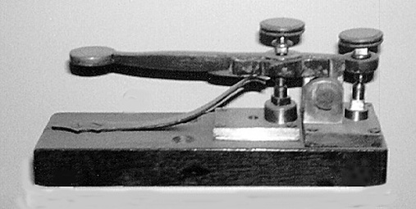

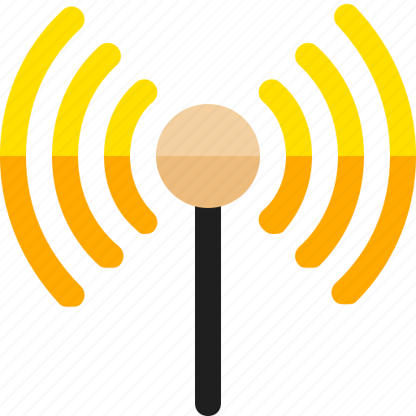
Tell Me About Telegraphs !
STEM Day IEEE @ UCF

Slide 3

The Electrical Telegraph
The electrical telegraph revolutionized long-distance communication in the 19th century.
It enabled near-instantaneous message transmission over vast distances!
Pioneered the foundation for modern telecommunications.

Slide 4
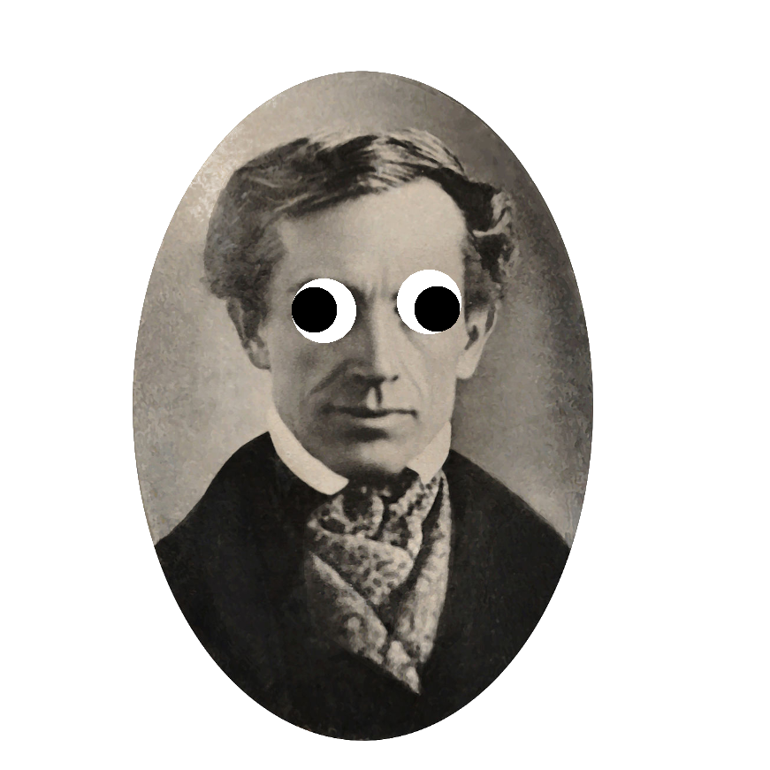
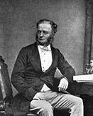
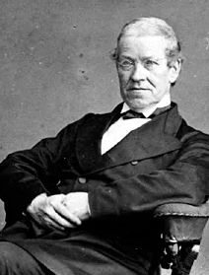

Who Made the Telegraph?
Samuel Morse Charles Wheatstone William Cooke
(Morse Code) Early Inventor Early Inventor

Slide 5
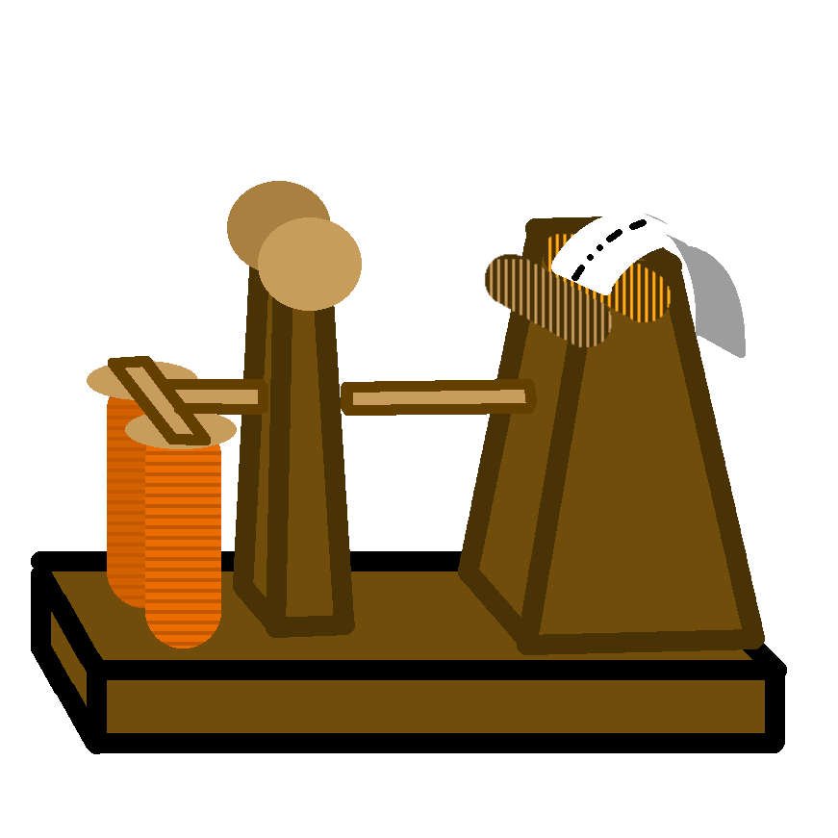

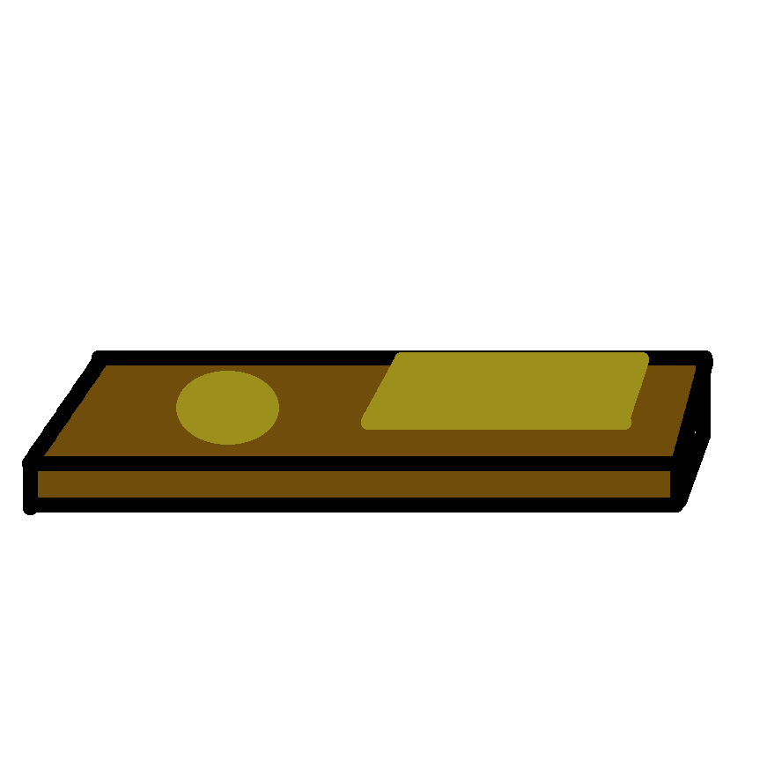
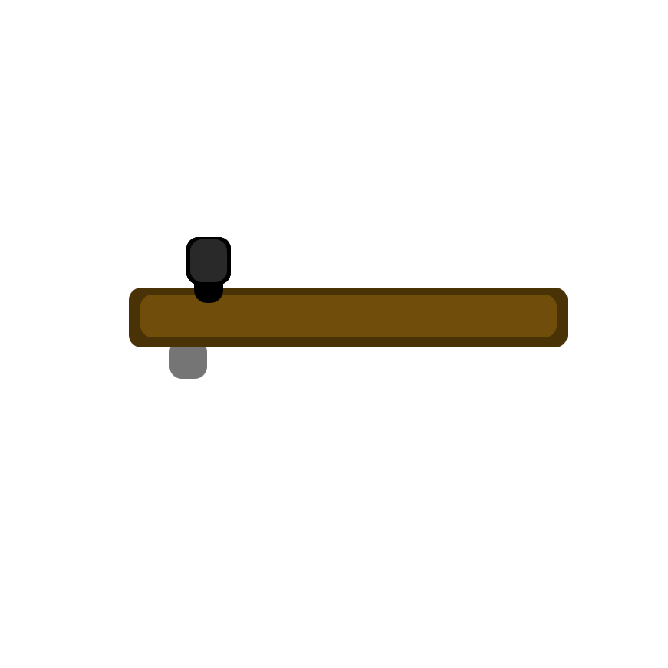
How Does It Work?
The electrical telegraph utilizes a series of dots (...) and dashes (- - -) to translate an Electrical Signal into Written Language. This process is called Morse Code.

Slide 6
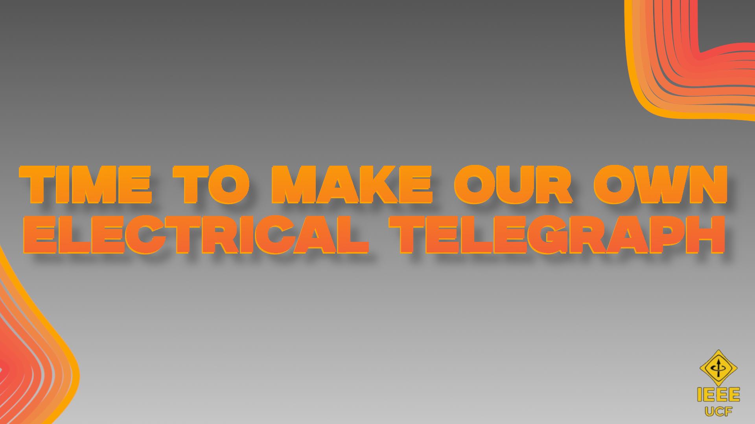

Slide 7
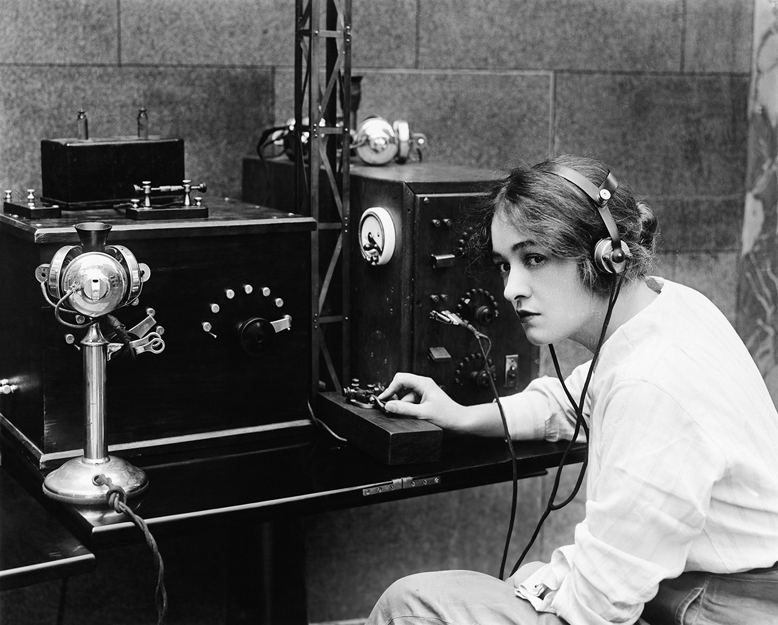
Let’s Make our Telegraph !

Slide 8

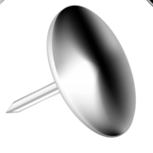
Materials
3 short, 4 in. wires and 3 longer, 8 in. wires.
Colored differently for visuals only.
Labeled for reference
2 LEDs
3 V Battery
4 Thumbtacks
-
A, B, C
D, E, F

Slide 9
-
Take two short wires (A, B) and tape down the exposed metal to the negative side of the battery
Take a long wire (E) and tape down the exposed metal to the positive side of the battery
+
A, B
Tape the battery with the 3 wires to telegraph A (as indicated in sheet)
Note: this is the same battery
E

Slide 10
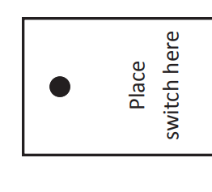
Put a metal tack on telegraphs A and B. Tape the bottom if it is pointy.
Take one of the short wires (A) on the negative side of the battery and wrap it around tack A.
Wrap long wire (E) and short wire (C) on tack B.
A
C
E

Slide 11
take the negative, shorter leg and attached it to the free wire that’s attached to the negative side of the battery (B).
Place a longer wire (F) and place it on the positive, longer leg of the LED.
Tape the LED with the wires as indicated in Telegraph A
Put the LEDs on the telegraphs as indicated and tape the following
On the shorter, negative leg of the LED:
A: Attach the (-) wire on the negative battery (B)
B: Attach short wire (C)
On the longer, positive leg of the LED:
A: Connect long wire (F)
B: Attach long wire (D)
-
+
B
F

Slide 12
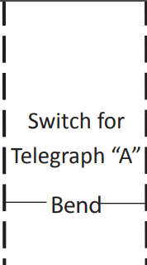
Put the other tack on the underside of the switch for both A and B
The tacks should be touching once connected
For the top tack,
A: Wrap long wire D
B: Wrap long wire F
Push down on the switch to complete the circuit.
You just made two working telegraphs :)

Slide 13
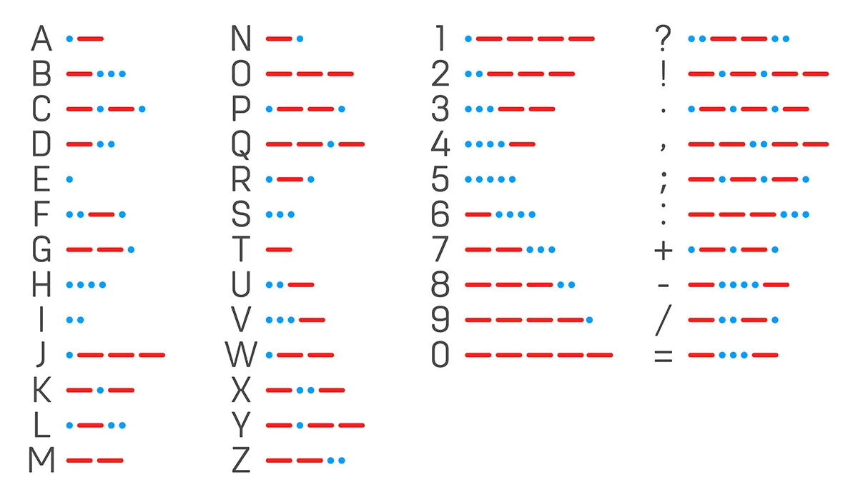

Slide 14

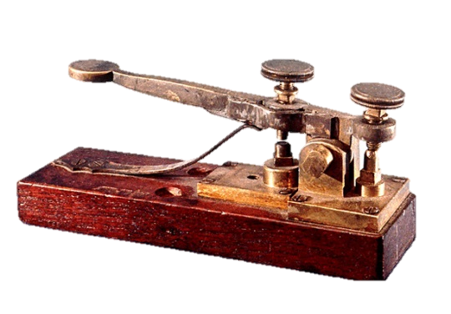
Ice breakers
Favorite color?
Name of a future pet?
One item you will bring on a stranded island?

Slide 15
Your Turn
Spend the rest of the time making fun messages between you and your partner :)

Slide 16


